Slide 1
Ventenata dubia
Compilation of Identification Resources

Slide 2
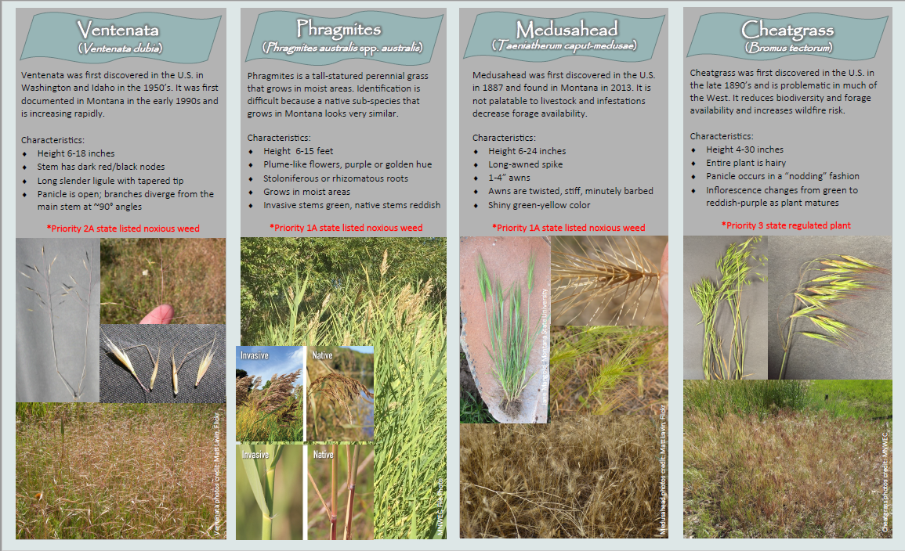

Slide 3
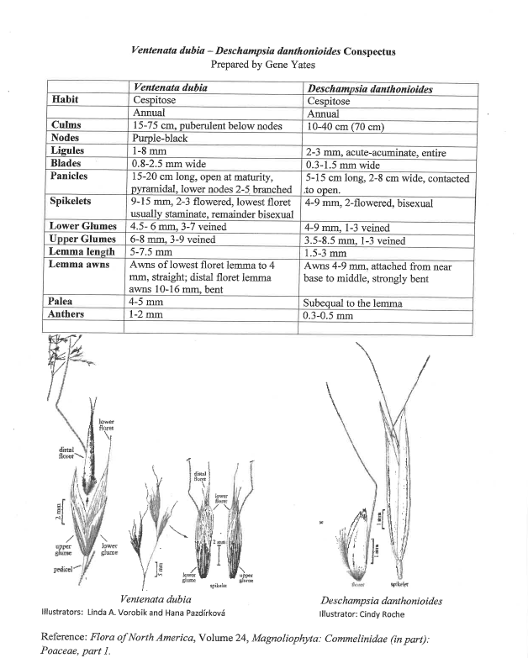

Slide 4
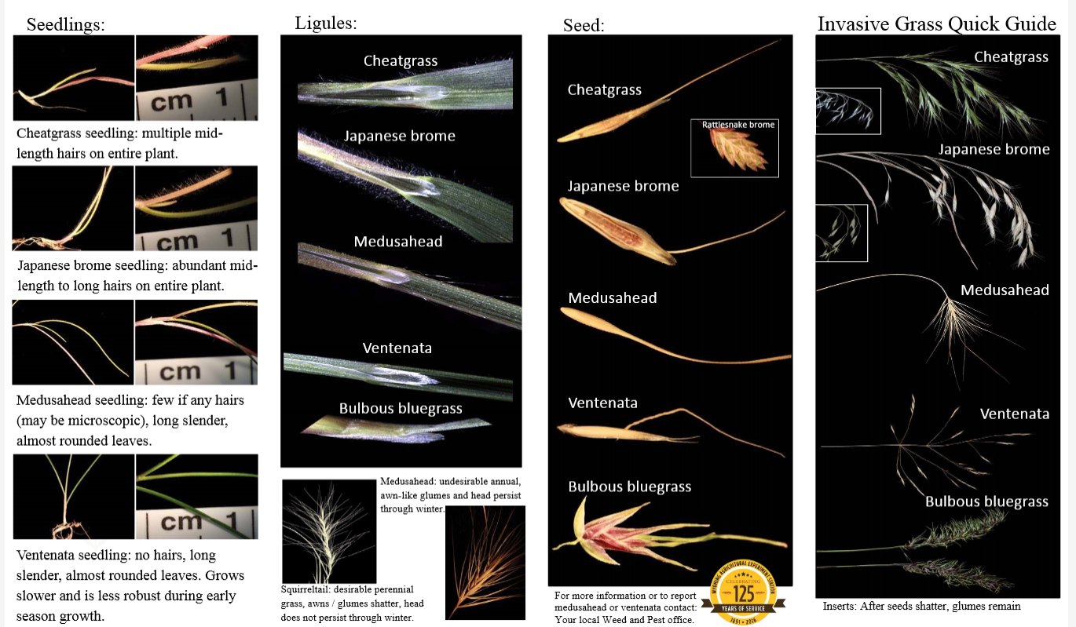

Slide 5
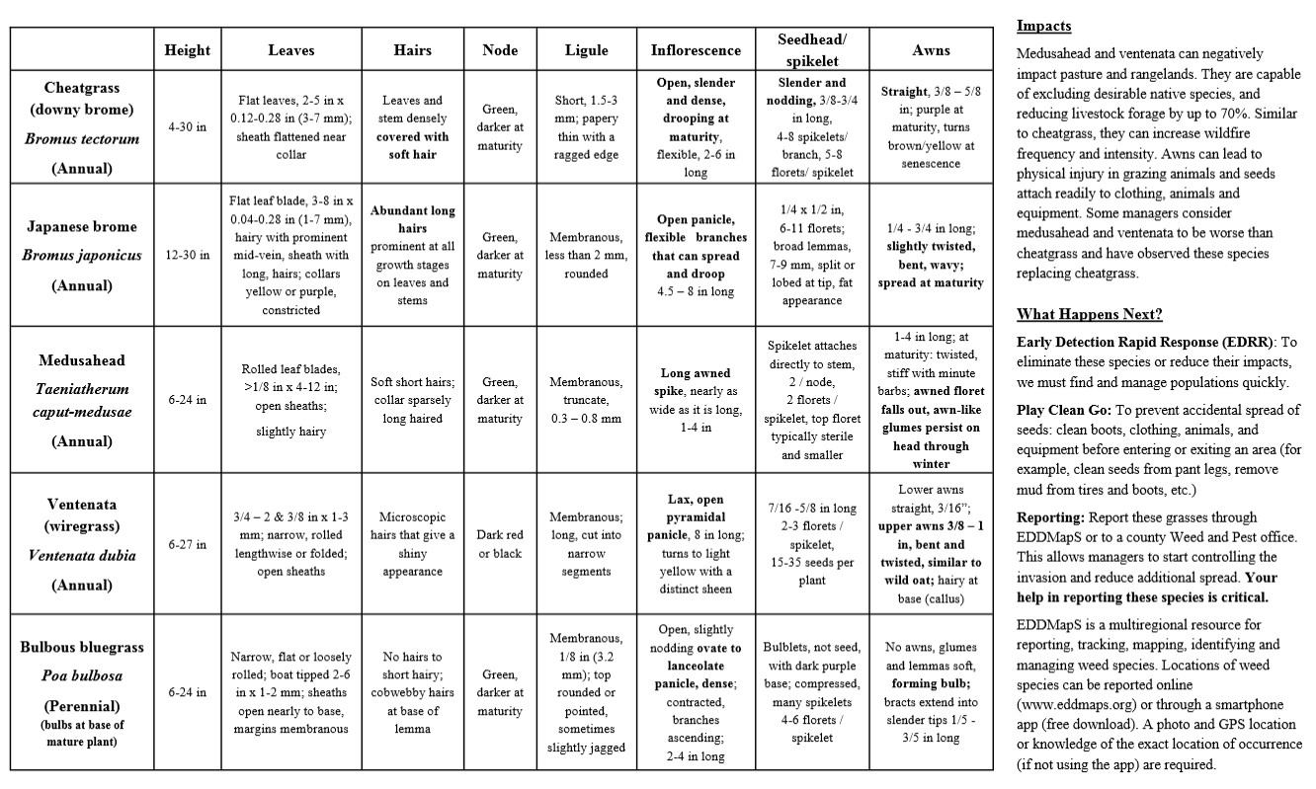

Slide 6
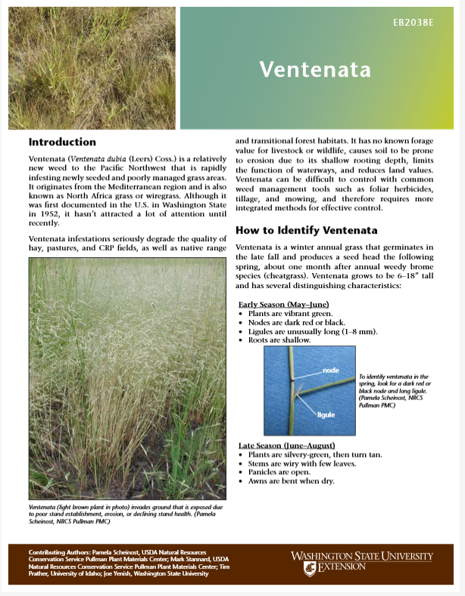

Slide 7
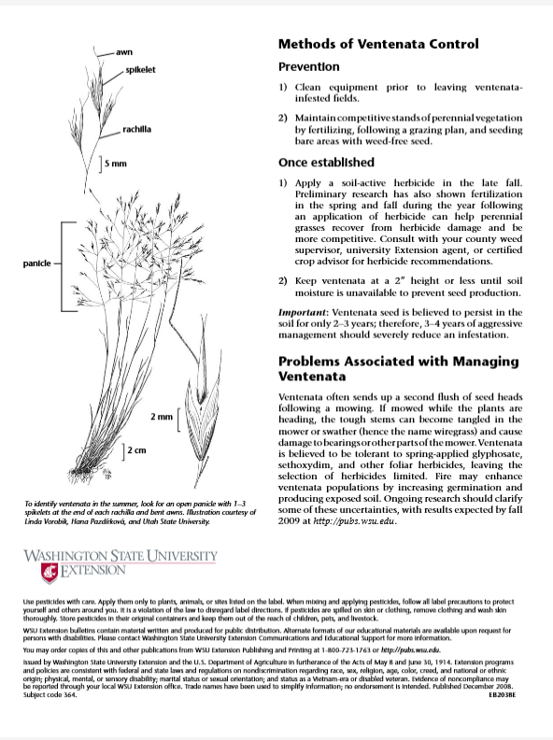

Slide 8
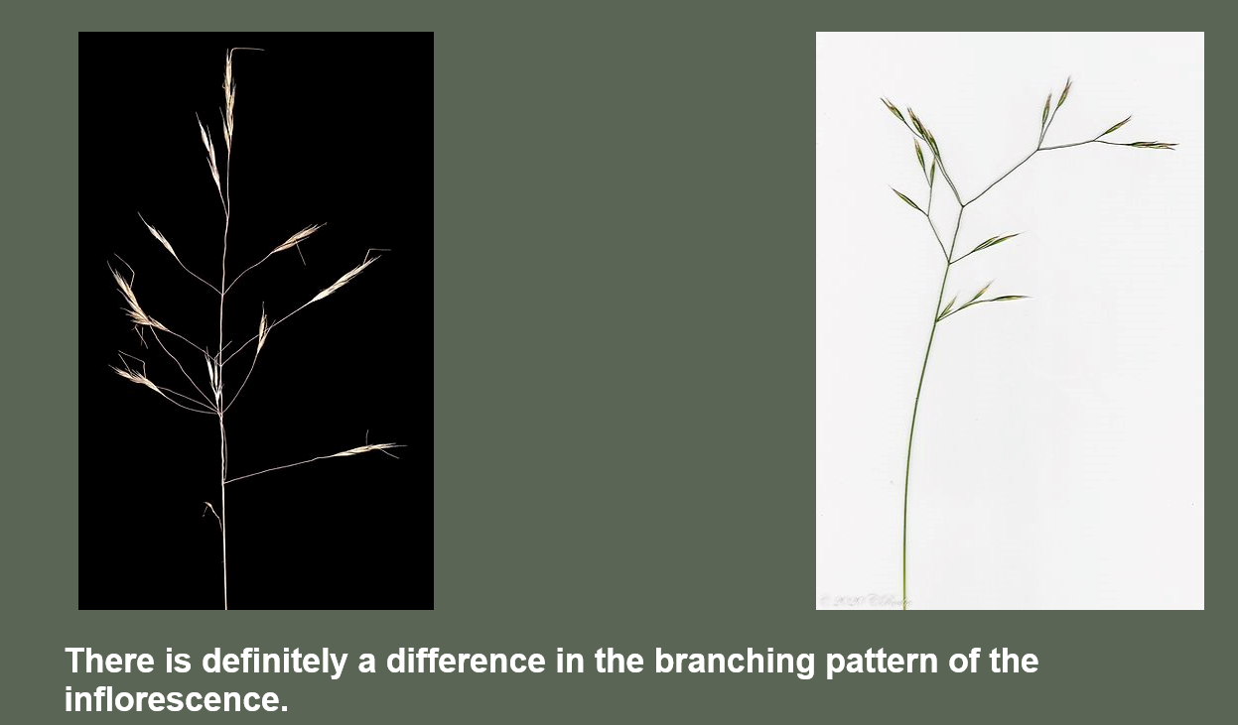
Ventenata dubia
Deschampsia danthonioides
Cindy Roche and Robert Korfhage 2020

Slide 9
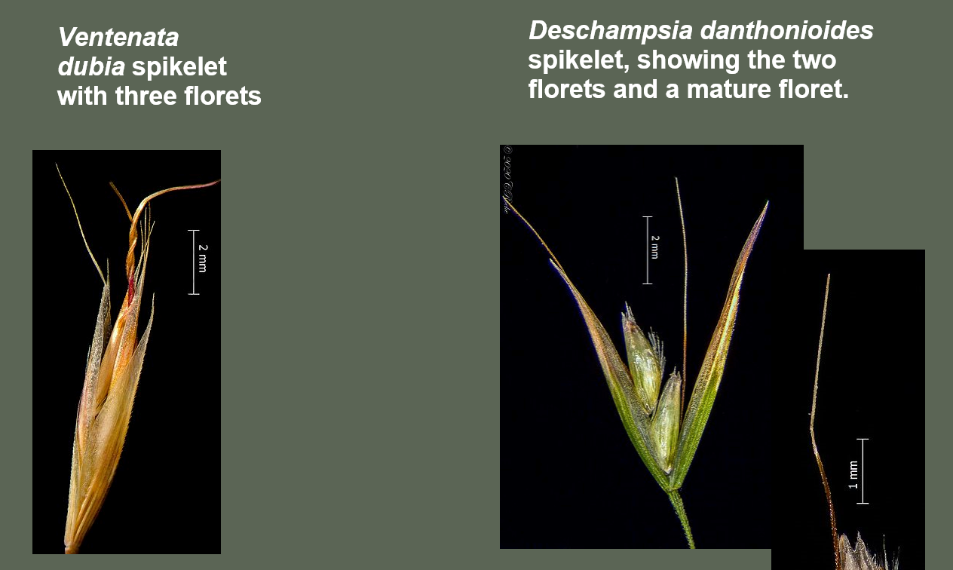
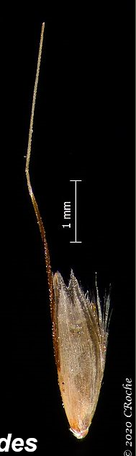
Cindy Roche and Robert Korfhage 2020

Slide 10
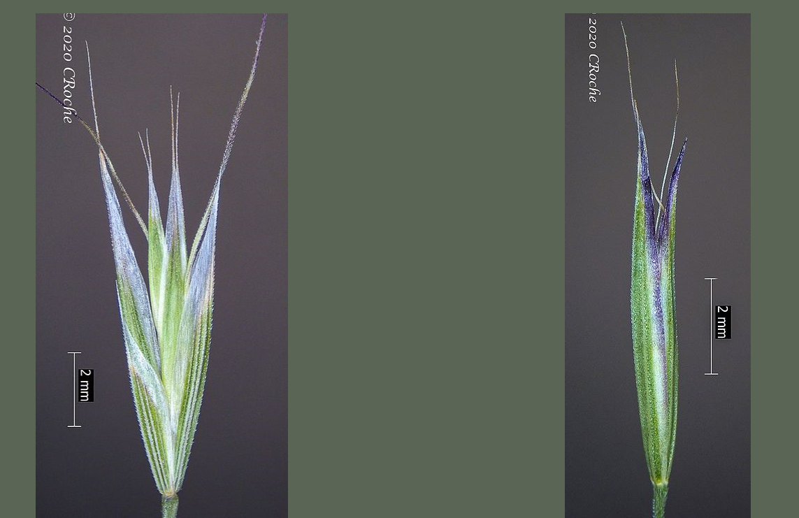
Ventenata dubia
Deschampsia danthonioides
Comparing the spikelets, you can see that the glume tips are often purple-tinged in Deschampsia and the glumes are equal in length and have a more slender silhouette. The glumes of Ventenata dubia have a hyaline margin (translucent) and are unequal in length. Also the veins are faint on the Deschampsia glumes and prominent on the Ventenata glumes. Glume characters are useful in looking at dry plant litter with empty glumes (no florets).
Cindy Roche and Robert Korfhage 2020

Slide 11
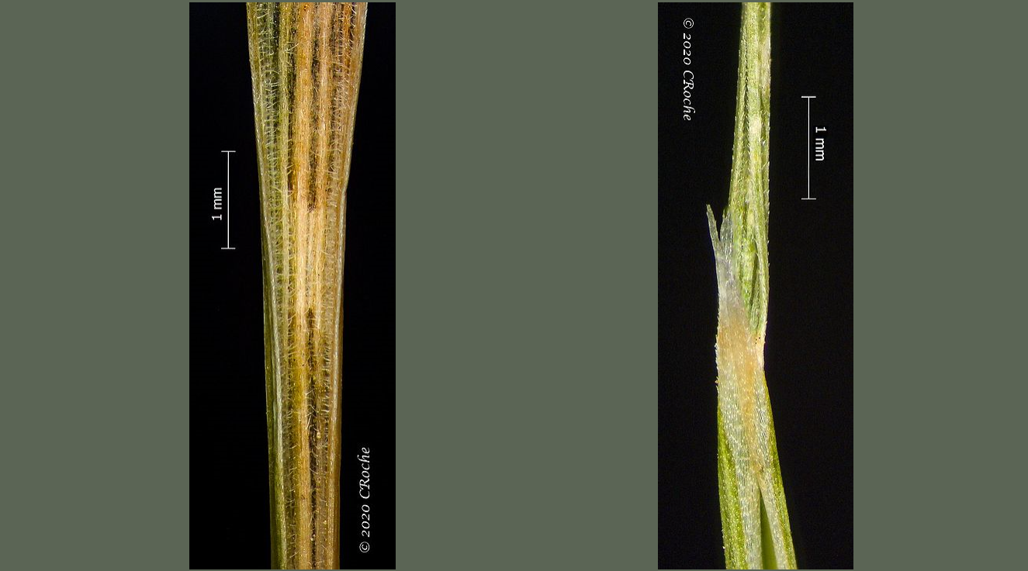
The leaves of Ventenata dubia average more than 1 mm wide. The one in the photo above is 1.5 mm where I flatted it. This measurement must be taken on unrolled (flat) leaf blades. Leaf blades of Deschampsia danthonioides are 1 mm or less wide. The other difference is the hairs on the upper surface of Ventenata leaves. The Deschampsia leaf blades have scabers along the edges and a few scabers on both surfaces, but no hairs.
Deschampsia danthonioides
Ventenata dubia
Cindy Roche and Robert Korfhage 2020

Slide 12
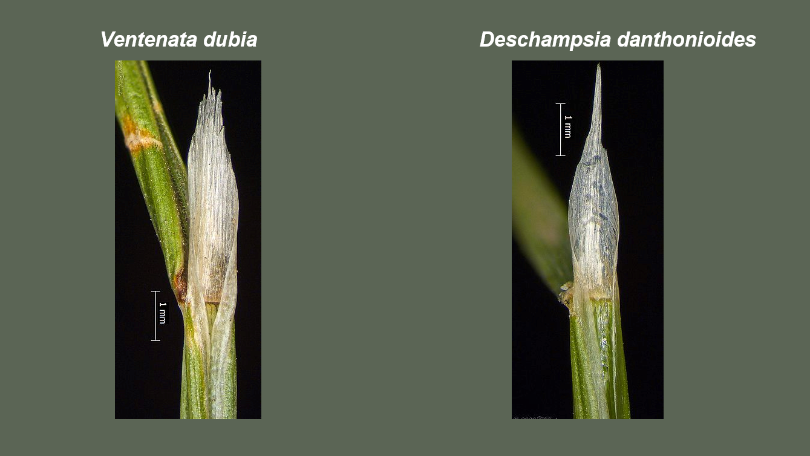
Now, this character may seem a bit subtle to you, but if I describe it, I hope you can see the difference. The ligule tip of Ventenata dubia is lacerate (raggedly torn looking). The ligule tip of Deschampsia danthonioides is acute or acuminate. When the plant matures and dries out, the ligule can break off and appear lacerate, but by that time you have flower characteristics.
Cindy Roche and Robert Korfhage 2020

Slide 13
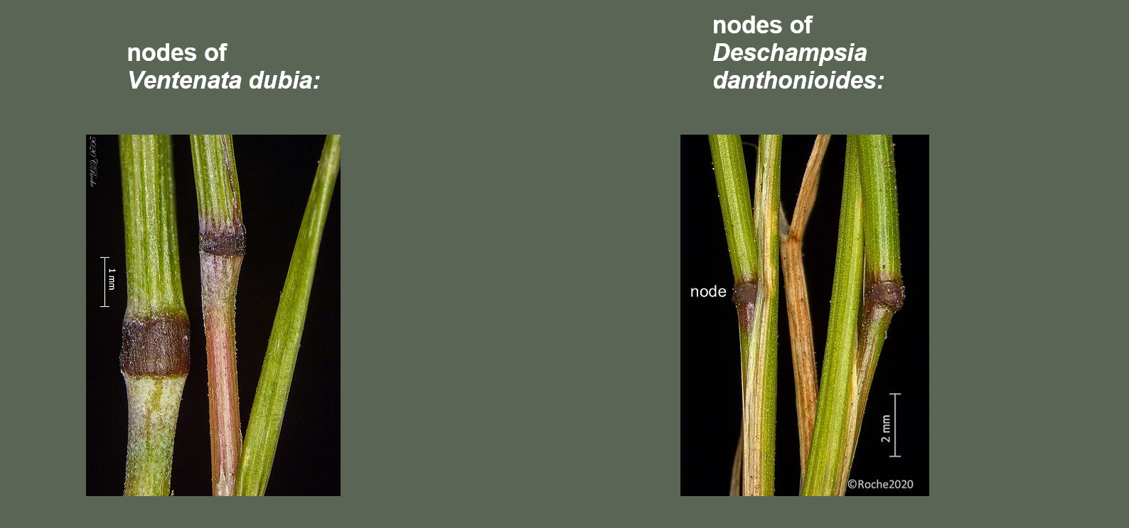
So, nodes are not particularly helpful.
Cindy Roche and Robert Korfhage 2020

Slide 14
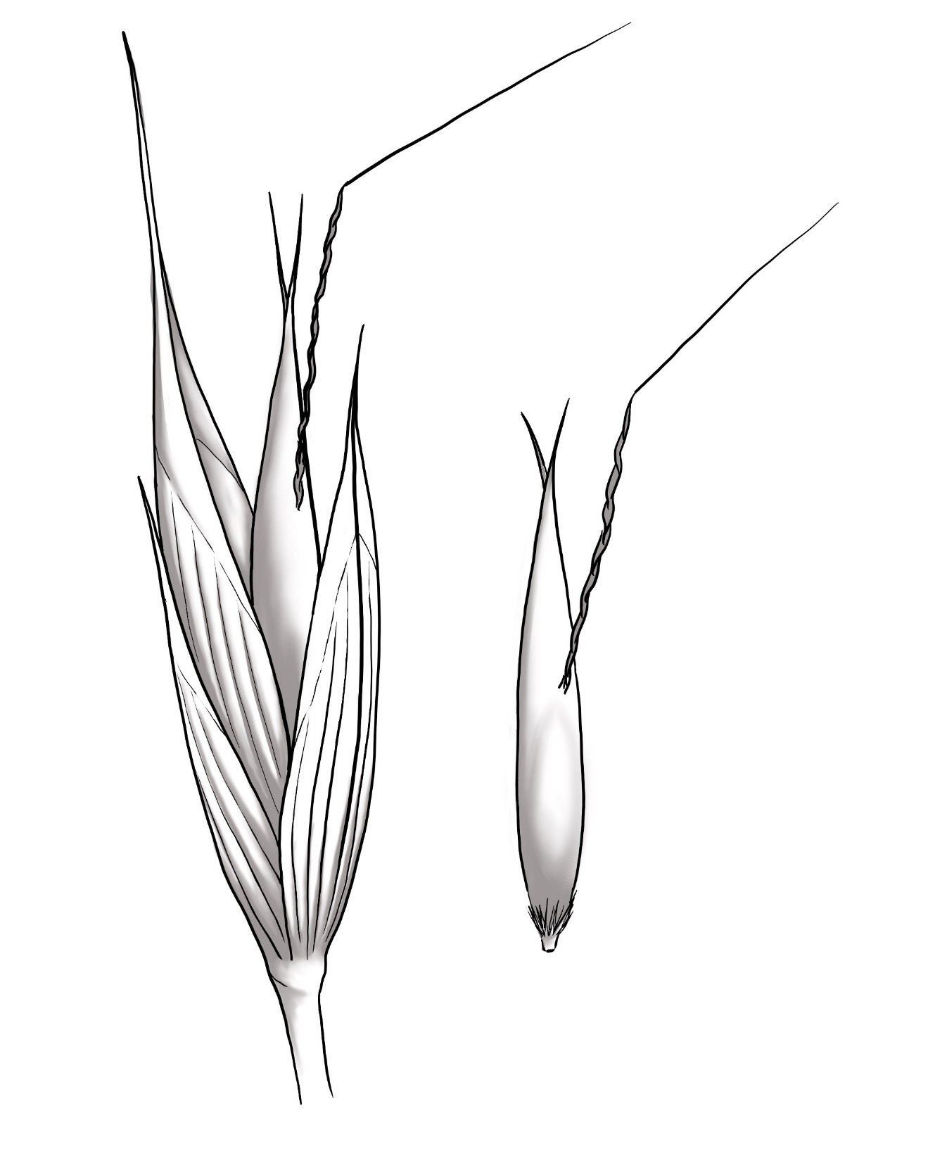
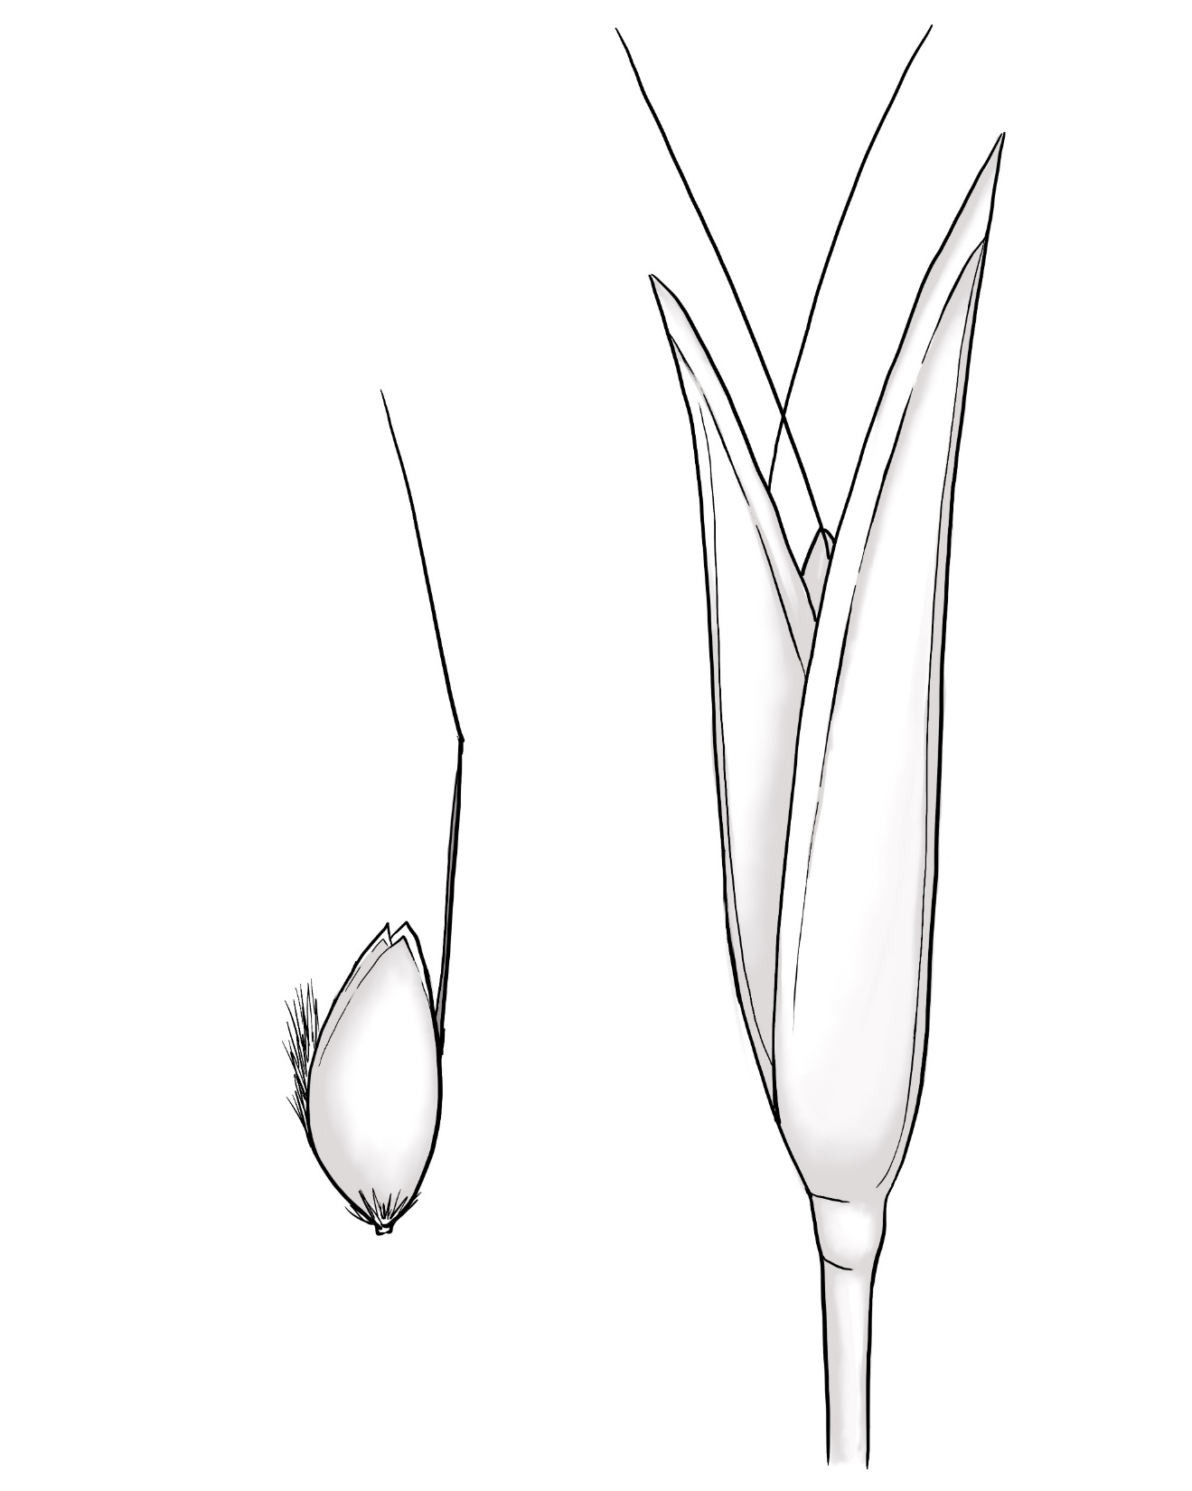
Spikelets
Ventenata dubia
Deschampsia danthonioides

Slide 15
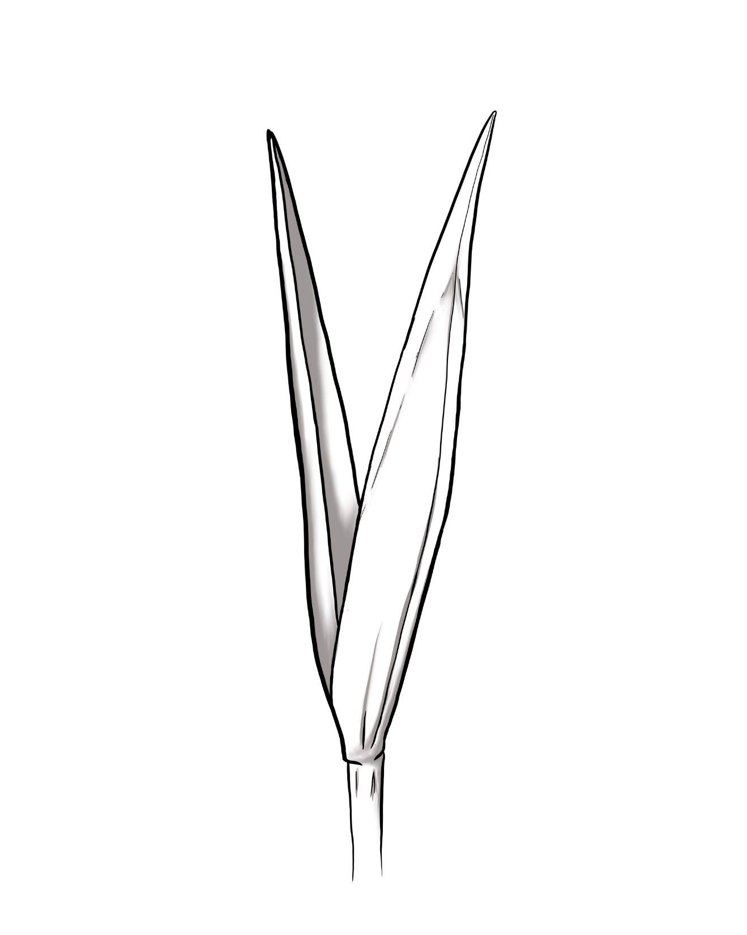
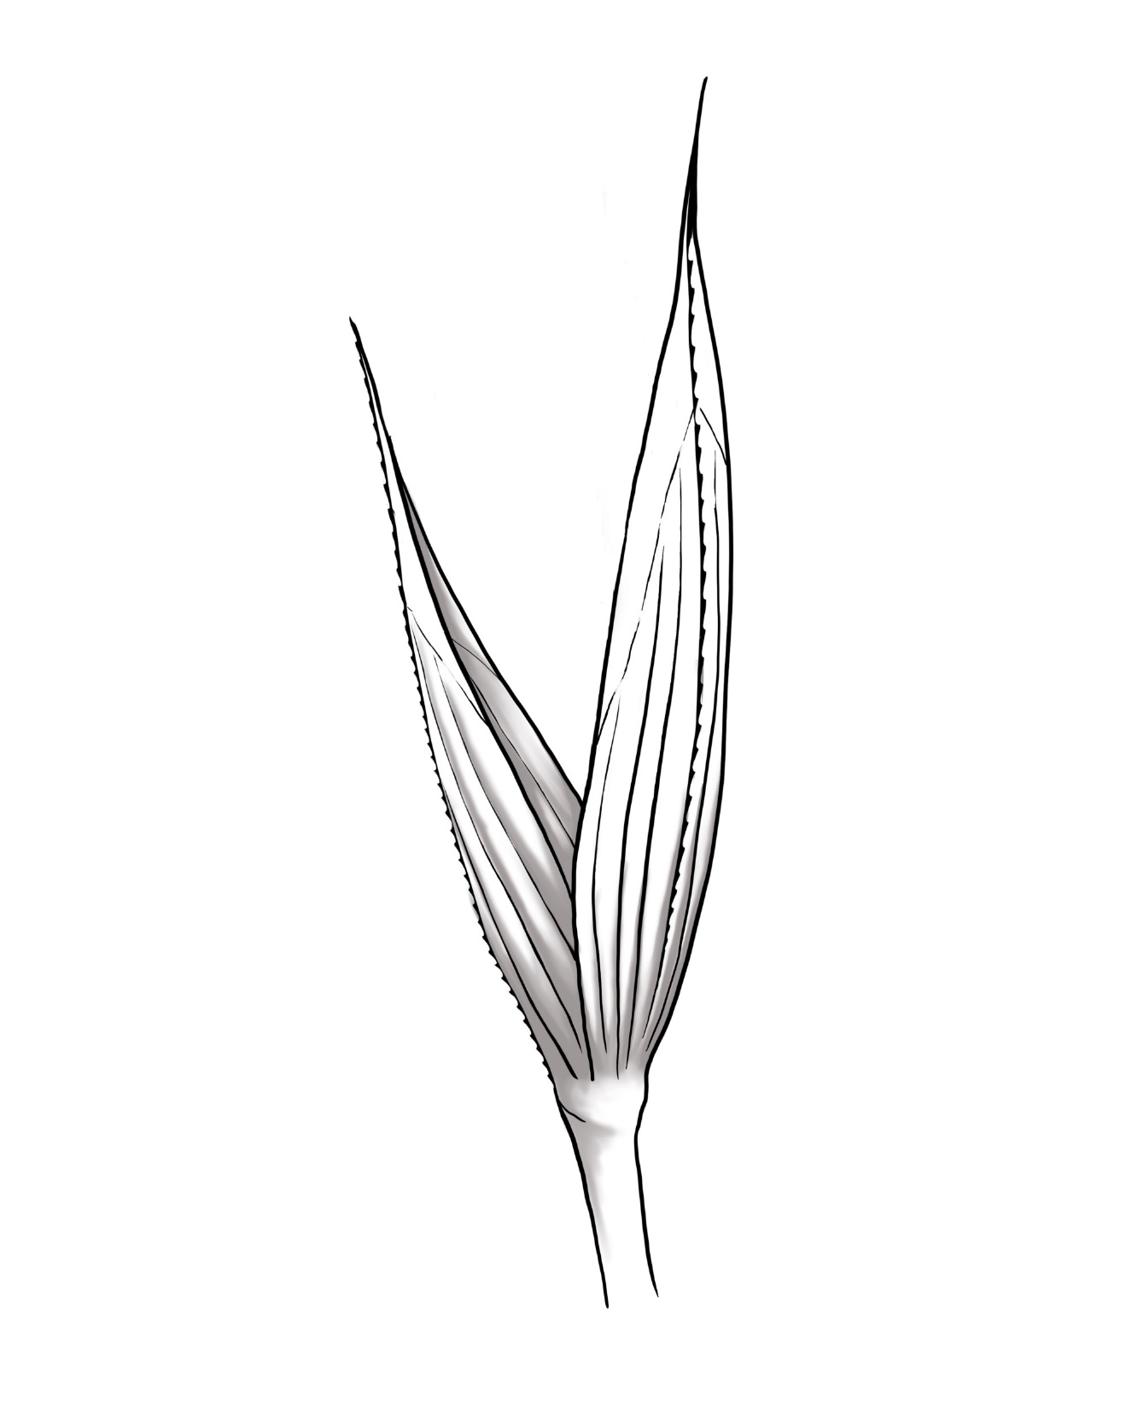
Glumes
Ventenata dubia
Deschampsia danthonioides

Slide 16
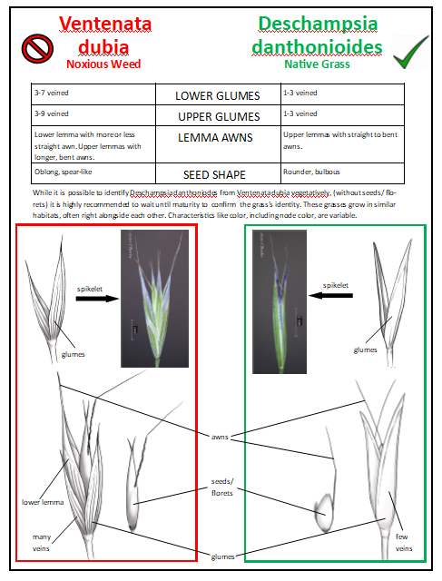
Guide and Digital art
by Bethany Reed
Malheur National Forest
431 Patterson Bridge Road, John Day, OR 97845, 541.575.3000, www.fs.usda.gov/malheur

